Slide 1
AstutëBell 2.0
Using Raspberry Pi ( OpenCV )
Internal Guide:
Prof. Tejasvee Gupta
Deepraj Darbar
Frank Macwan

Slide 2

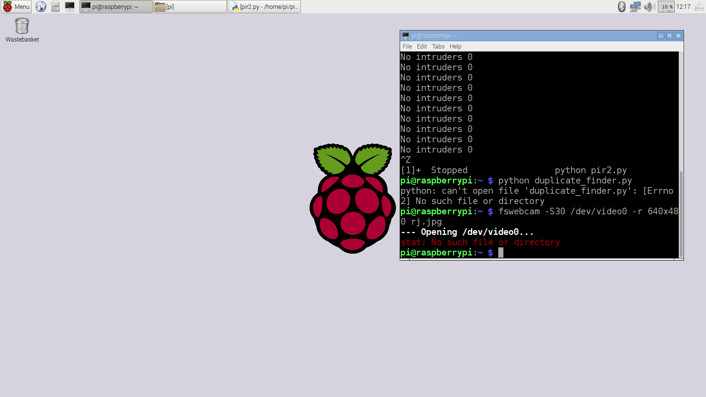

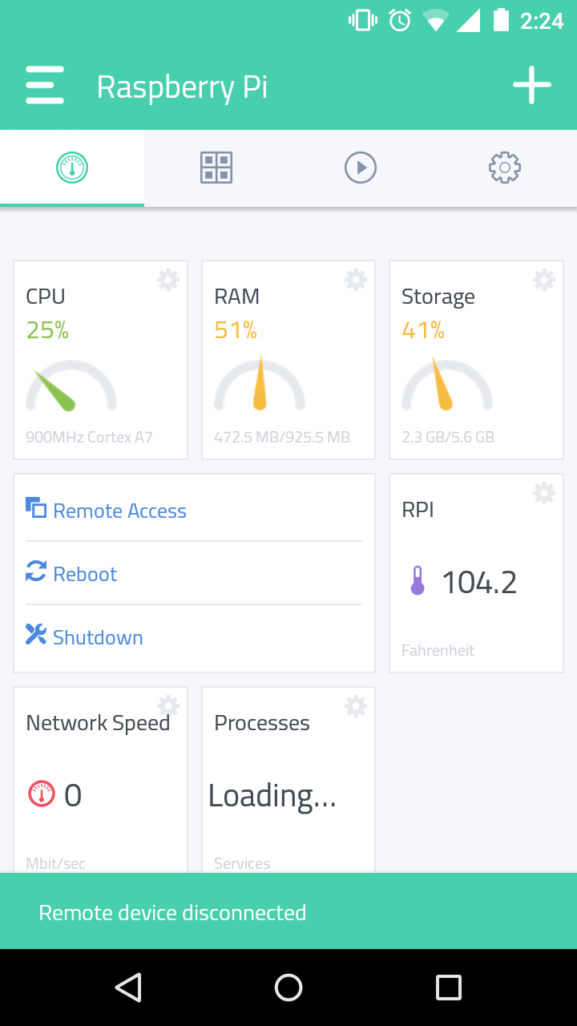
AstutëBell
A Smart Doorbell which is smart enough to sense human presence with integrated face detection, trigger a photo capture and send notification to the registered users.

Slide 3

Why IoT?
" The best way to predict the future is to create it "
-Abraham Lincoln

Slide 4
Abstract
A doorbell that will notify you in real-time , That is something very new and innovative. It uses a PIR Motion Sensor to detect human presence, Pi Cam for Detecting and capturing photos/videos and a special dovetail of Python Code to commingle all the modules and sends you a notification on your mobile on-the-go.

Slide 5
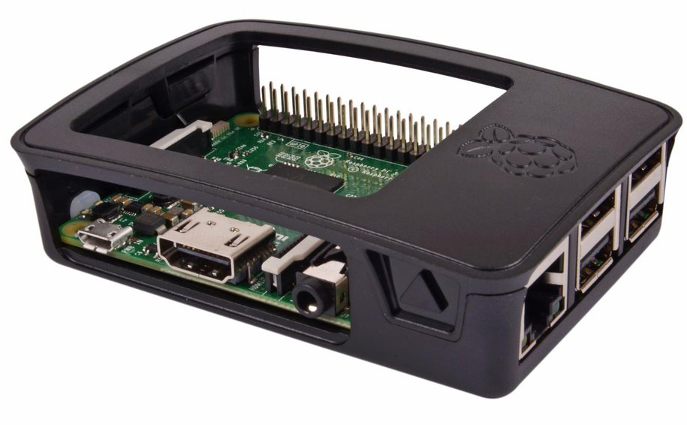
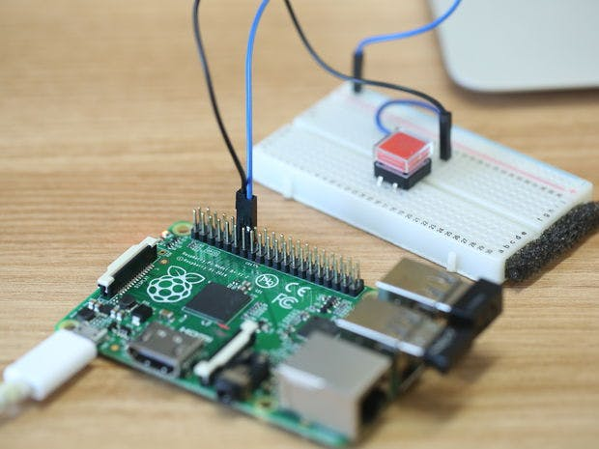
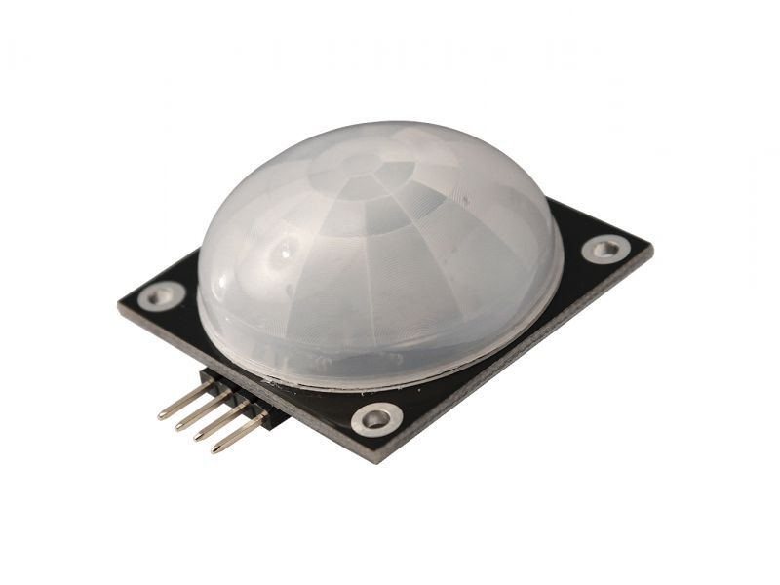
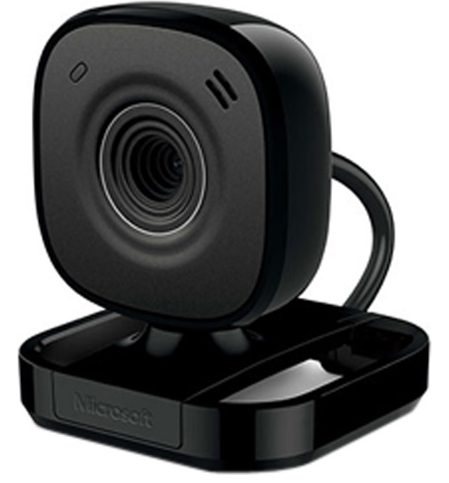
Components View

Slide 6
Features
Face Detection (Photo Capture + Saved to Cloud )
Real-Time Notification(App)
Cloud Storage for 24*7 access to photos from anywhere
Face Recognition of registered users

Slide 7
Existing Products

Slide 8
Literary Survey
Existing products used in India are just a normal indoor audio/video intercom applications.
Some international companies have manufactured similar products with enhanced functionality. August Inc and Skybell Inc
A similar project based on Win 10 IoT Core using Azure cloud services is under development. Hackster.io & Instructables.com.
Overall, the scope of this project will be extended further with display modules and security provisions , which can enhance its functionality.

Slide 9
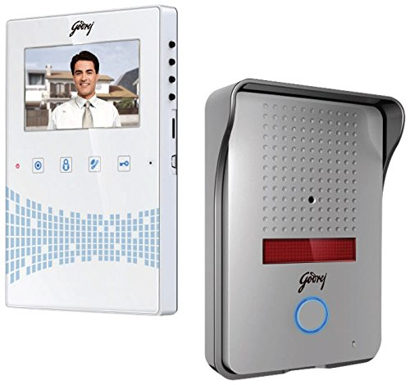
Nationally Available
A widely used godrej seeThru appliance which can display the image/video outside of your home as and when the bell is pressed.
And it costs around 8.2K & above(with added features like storage etc.).
Here is an image of the variant mentioned above.

Slide 10
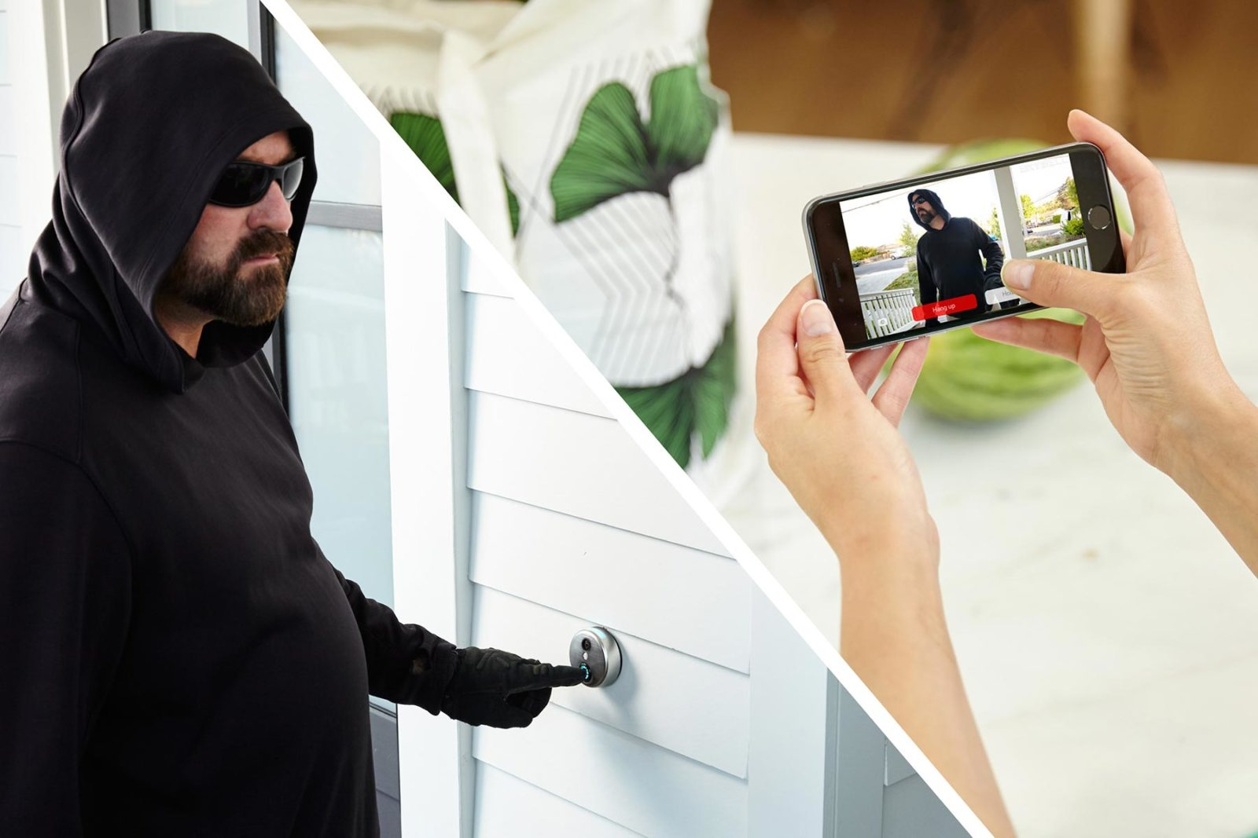
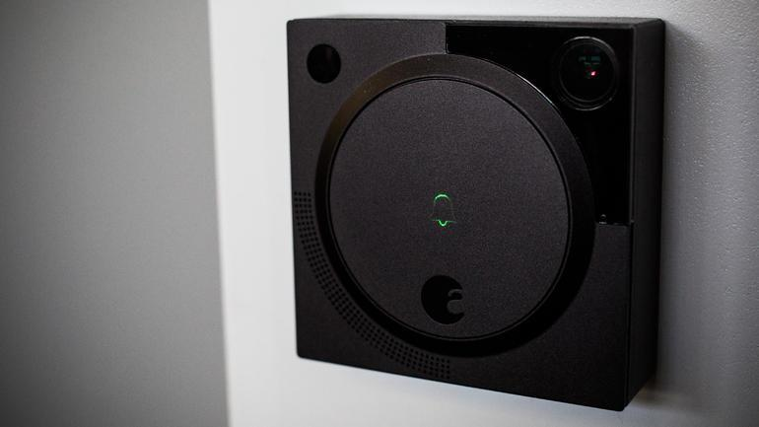
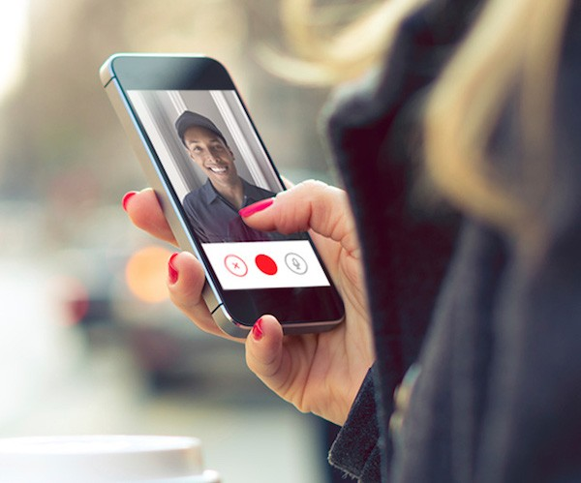
Internationally Available

Slide 11
Proposed v/s Existing
A round-the-clock anywhere you go stream available.
Sensor to sense and capture a photo.
If user is away, he/she can still view the image/video later or simultaneously.
An SMS/Email Notification Module displaying alert signal
Face Recognition to identify registered users
Only indoor video streaming available
to the device.
No such sensors available and if present, it only rings door bell.
If owner away, doorbell doesn't serve it's purpose.
No notification module present.

Slide 12
Circuit Diagram

Slide 13
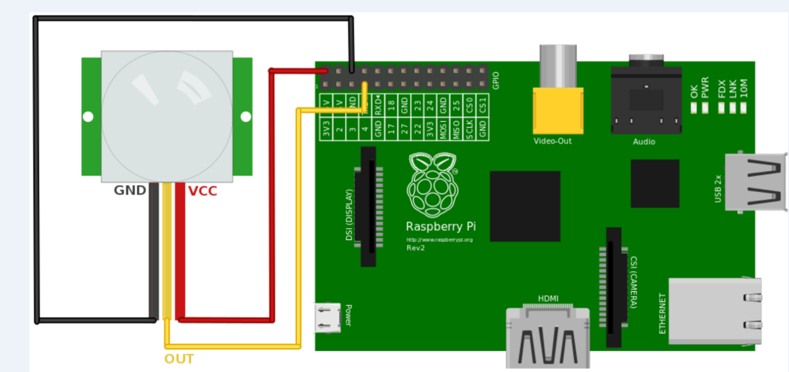

Slide 14
UML Diagrams

Slide 15
System Architecture (Flow)

Slide 16
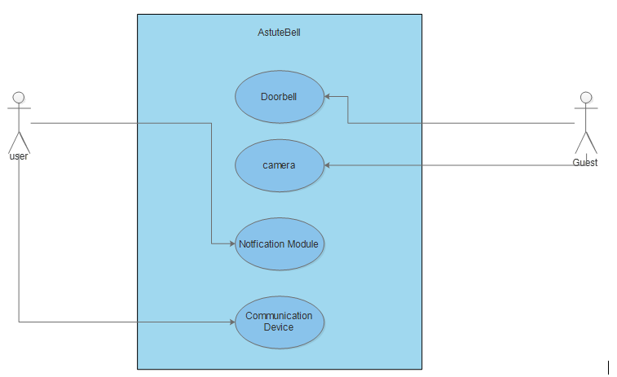
Use Case Diagram

Slide 17
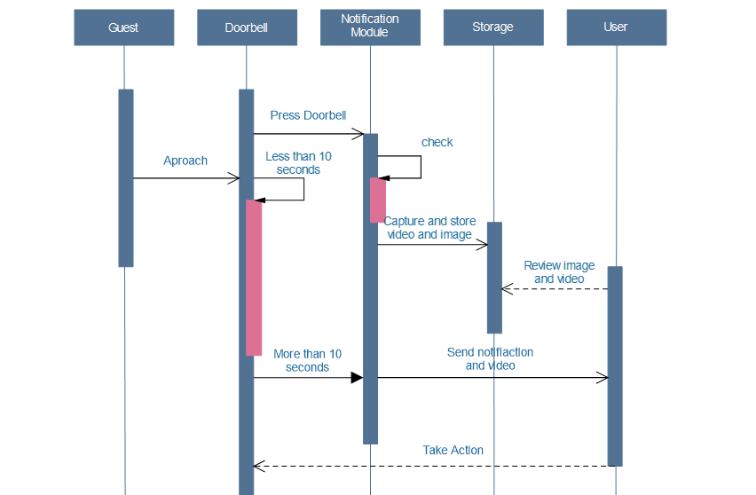
Sequence Diagram

Slide 18
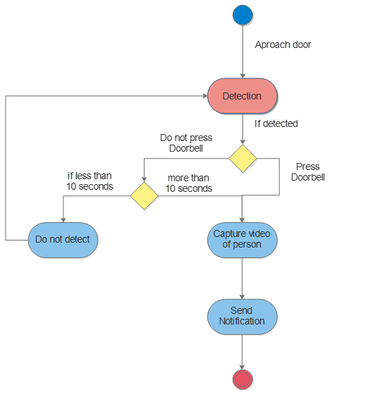
Activity Diagram

Slide 19

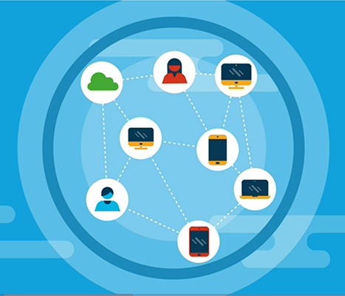
Thank You
Deepraj Darbar
1418BECE30024
Frank Macwan
1418BECE30030

